Slide 1

Al al-Bayt University
Prince Al Hussein bin Abdullah College of Information Technology
By:
Nadeen Haswah & Randa Almansi
Supervisor :
Dr . Mazen Alzyoud

Slide 2
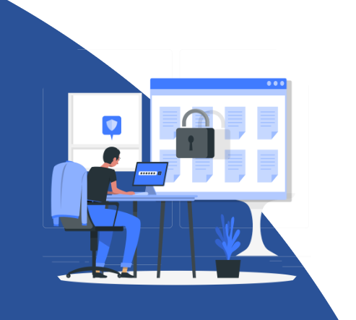
INTRODUCTION
In today’s fast-paced digital world, efficient task and team management are critical for productivity. Traditional methods like Excel, paper-based tracking, and fragmented communication tools (e.g., WhatsApp/Email) lead to data loss, wasted time, and lack of transparency.
Our project, [Manage Ease], is a centralized, automated platform designed to streamline task management, enhance collaboration, and provide real-time insights for teams. By integrating intuitive features like visual boards, smart labels, automated reports, and role-based access, we bridge the gap between chaotic workflows and modern, agile solutions.
Manage Ease

Slide 3
PROBLEMS
1️⃣
Chaotic Legacy Systems
Manual tracking (Excel/paper) → Data loss and inefficiency
2️⃣
No Centralized Hub
Over-reliance on WhatsApp/Email → Missed updates and disorganization
3️⃣
Wasted Time & Resources
Lengthy meetings for progress updates → Reduced productivity
4️⃣
Lack of Transparency
Team members unaware of project status → Delayed decisions
Manage Ease

Slide 4
PROPOSED SOLUTION
1️⃣
2️⃣
Centralized Digital Task Management
. Board View: Visualize tasks as Cards in Lists (To-Do, In Progress, Done)
. Table & Timeline Views: CRUD operations and drag-and-drop scheduling.
All-in-One Collaboration Hub
. Real-Time Notifications: Alerts for task updates
. In-App Chat & Sticky Notes: Replace external tools like WhatsApp.
3️⃣
4️⃣
Automated Progress Tracking
. Live Dashboards: Show task completion (e.g., "4/7 tasks done").
. Auto-Generated Reports: Email summaries for managers.
Transparent Workflows
. Color-Coded Labels: Prioritize tasks (e.g., Red = Urgent)
. Role-Based Access: Control visibility (e.g., Team Members vs. Managers).
Manage Ease

Slide 5
OBJECTIVES
1️⃣
Eliminate Manual Tracking → Reduce errors and data loss
2️⃣
Enhance Team Collaboration → Centralize communication
3️⃣
Save Time → Automate updates and reports
4️⃣
Boost Competitiveness → Modernize workflows
Manage Ease

Slide 6
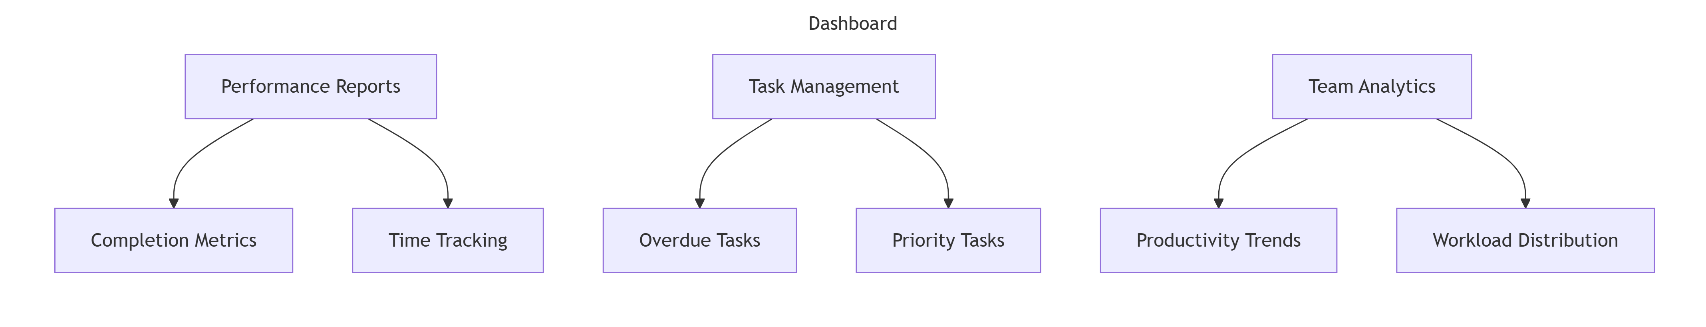
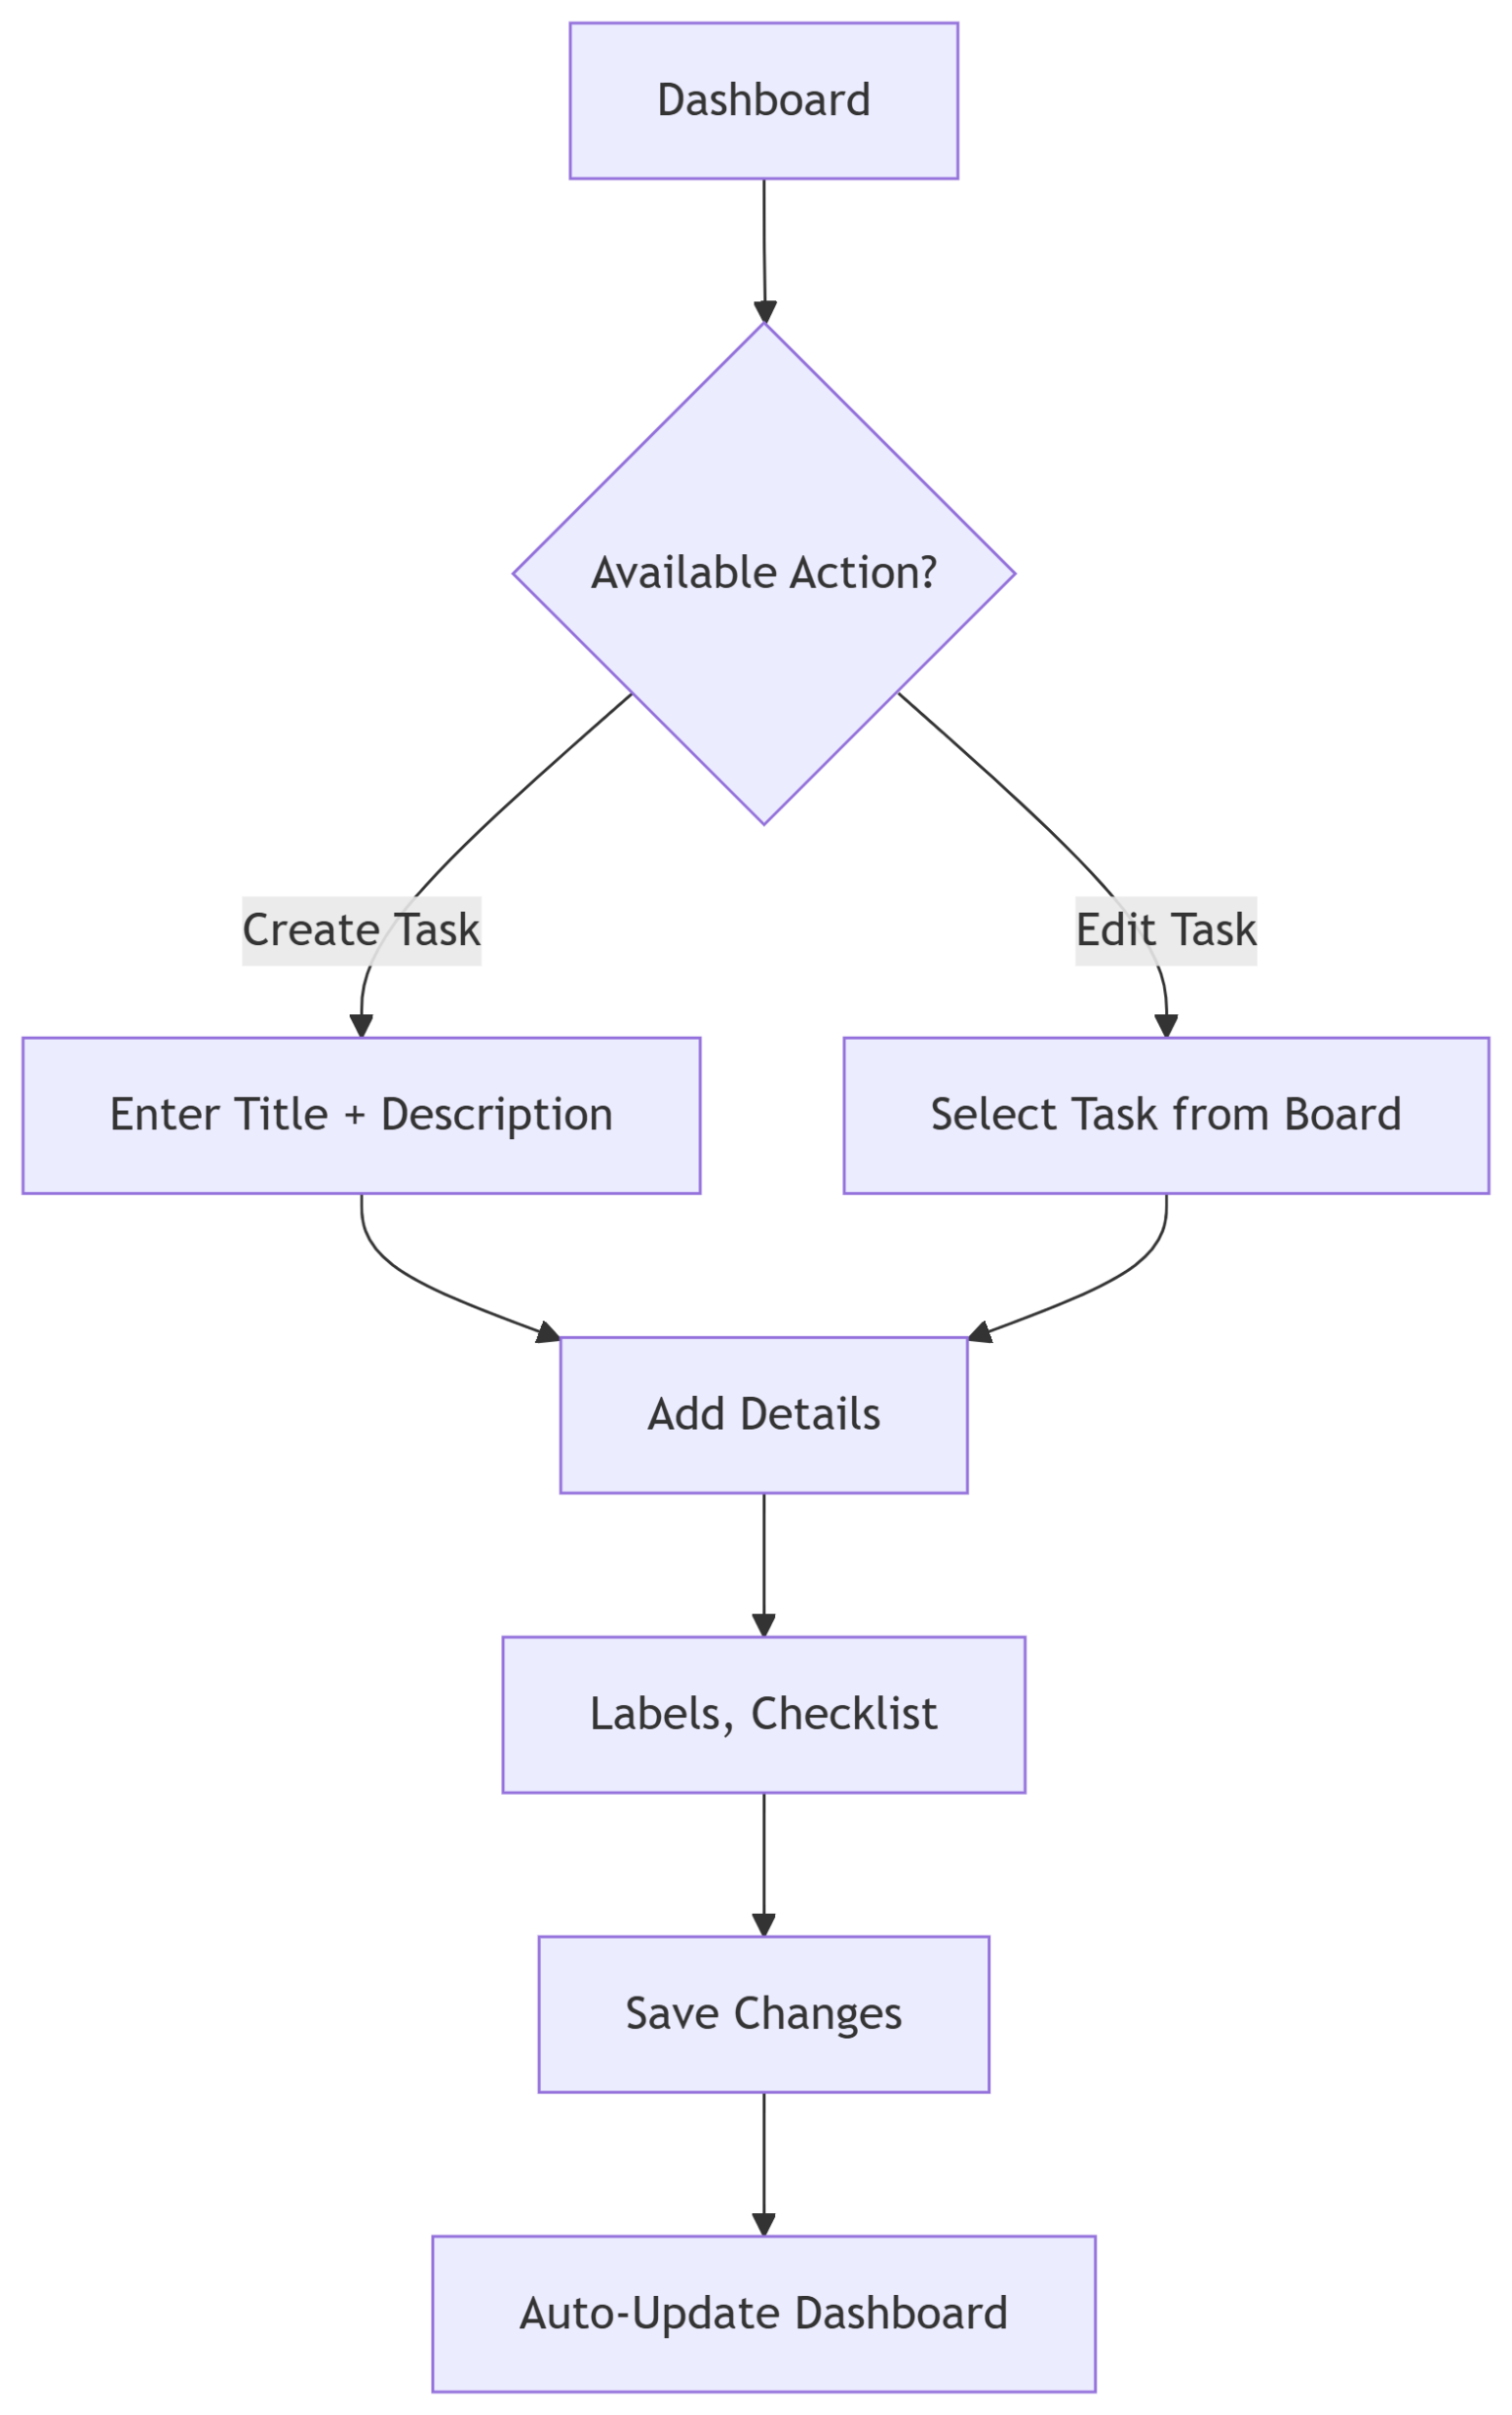
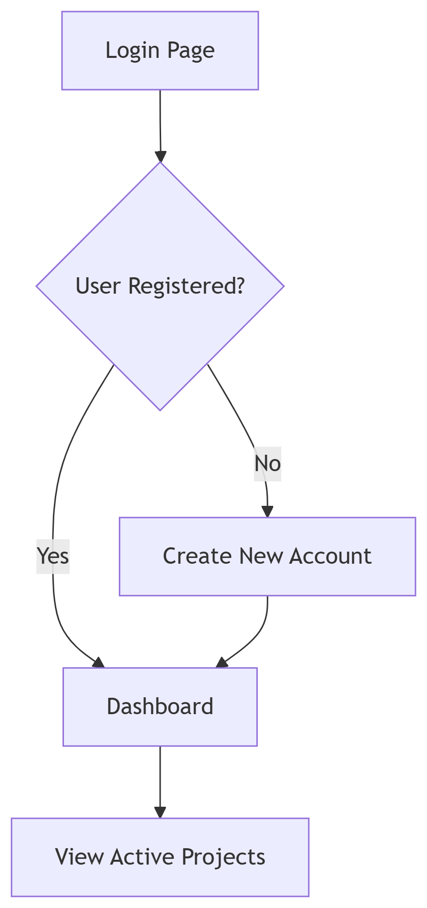
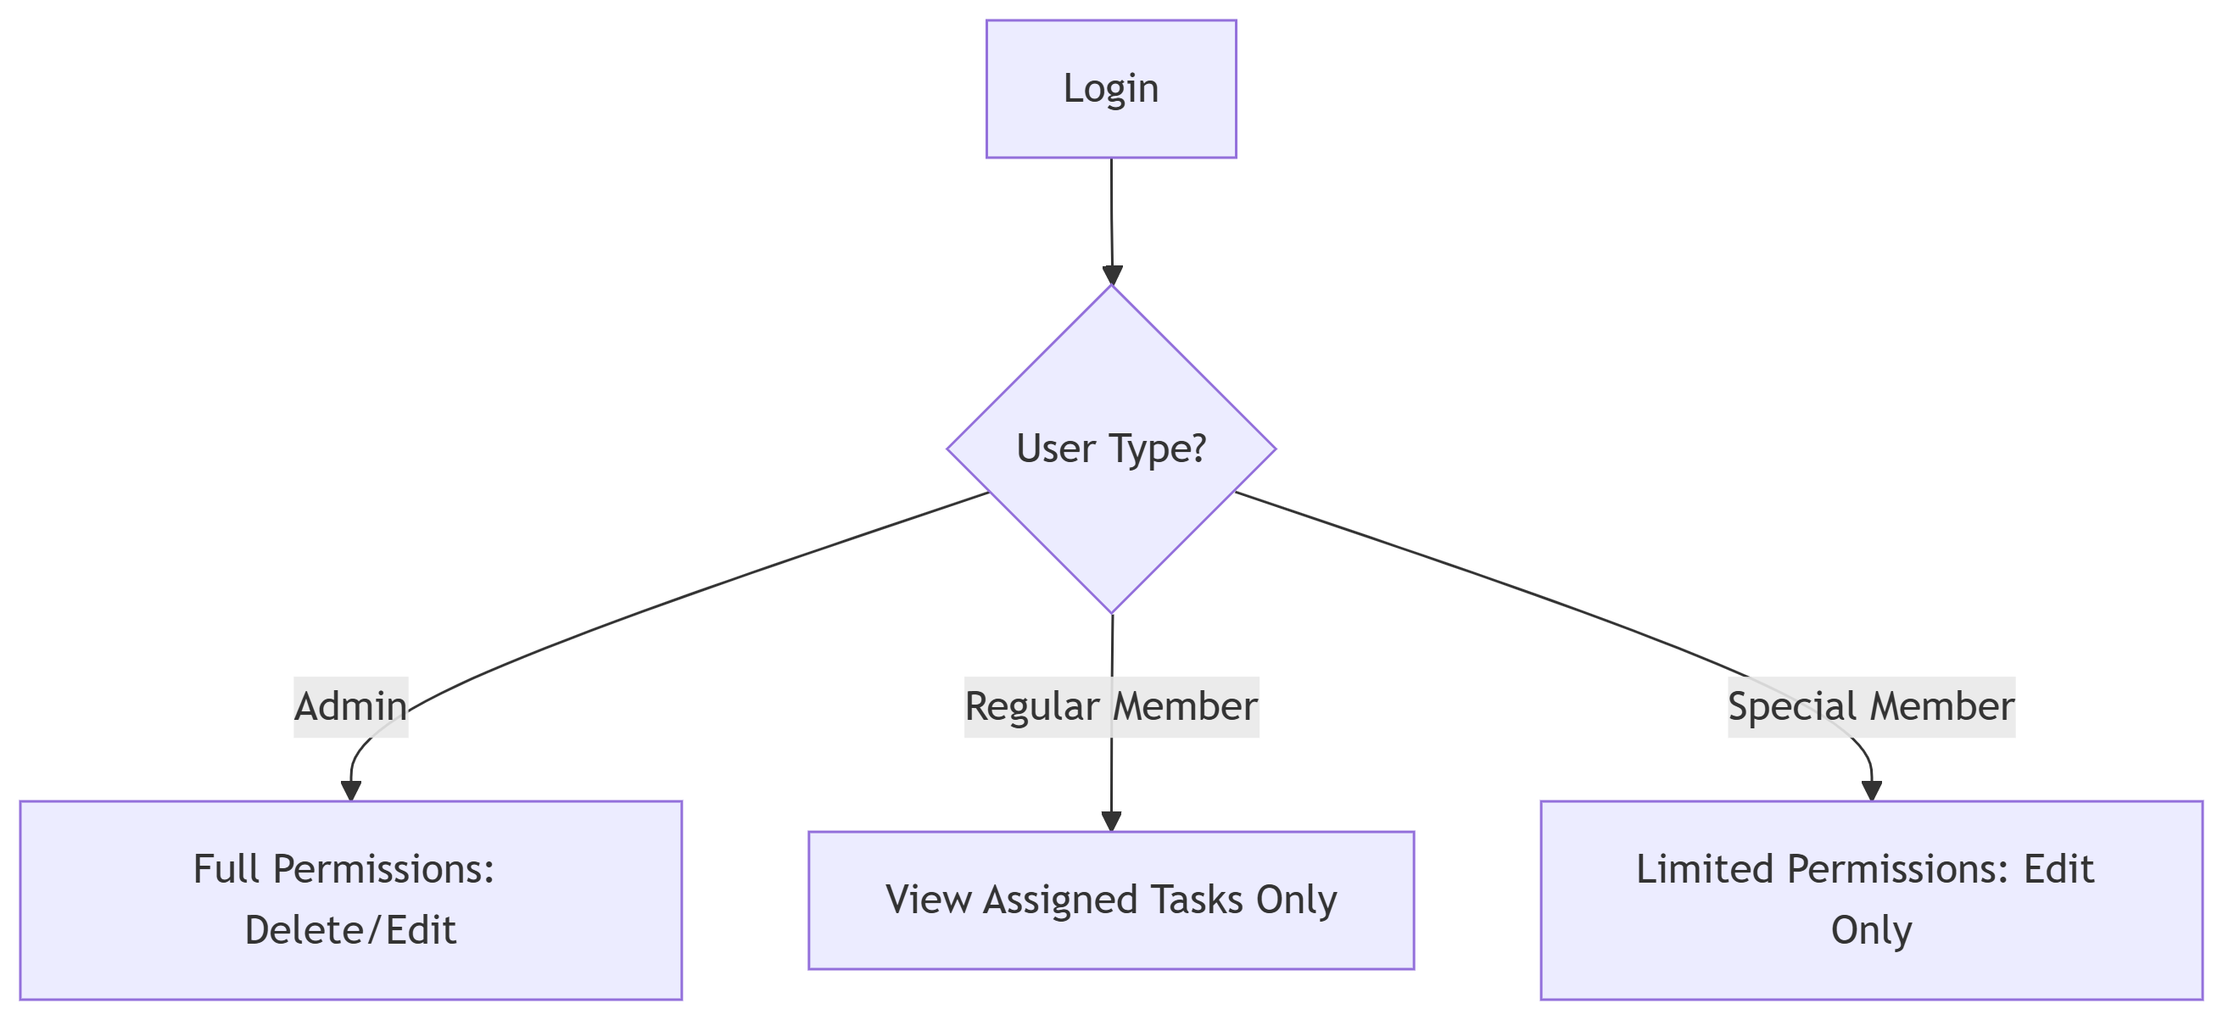
Manage Ease

Slide 7
🔒 Security Protocols Implemented
1️⃣
Password Protection
✅ Hashed Passwords
✅ Minimum 8 Characters + Special Characters
✅ Auto-Lock after 5 failed attempts
2️⃣
Attack Prevention
🛡️ SQL Injection → Parameterized Queries
🛡️ XSS Attacks → Input Sanitization
🛡️ CSRF → Anti-Forgery Tokens
3️⃣
Session Security
🔄 Session Regeneration on Login/Logout
⏳ Timeout after 30 mins of inactivity
Manage Ease

Slide 8
TECHNOLOGIES USED
1️⃣
Frontend: Bootstrap & tailwind
2️⃣
Backend: php
3️⃣
Database: phpMyAdmain
Manage Ease

Slide 9
USER INTERFACE
Manage Ease

Slide 10
Al al-Bayt University
Prince Al Hussein bin Abdullah College of
Information Technology
THANK YOU

